Slide 1
Example Candidates
Module 1 · recent real-world examples for review
One slide per candidate. Facts verified against the sources listed on each slide (retrieved 2026-08-20). Adopted candidates get the full visual treatment (images, native charts) when ported into the main deck.

Slide 2

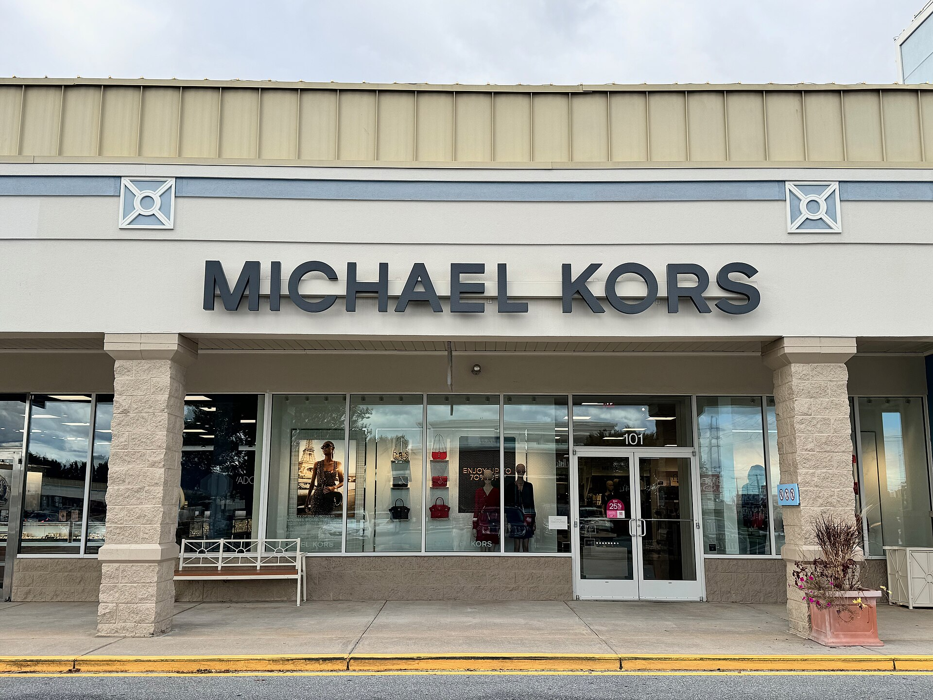
Module 1 · Candidates · Market Definition
Market Definition Mini-Case: Tapestry–Capri
Aug 2023: Tapestry (Coach, Kate Spade) agrees to buy Capri (Michael Kors, Versace) for $8.5B
The definition of the market would turn out to be crucial for the case:
FTC: the market is “accessible luxury” handbags — roughly $100 to under $1,000
The firms: the market is all handbags — from fast fashion to Hermès — and entry is easy
Photos: Wikimedia Commons
Management 405 · Module 1 · Example Candidates (for review)
2
Notes:
Expanded from the candidate list (research verified 2026-08-20). Preliminary injunction: Judge Jennifer Rochon, S.D.N.Y., 24 Oct 2024 (169-page opinion); FTC administrative suit filed 22 Apr 2024; merger agreement terminated 13 Nov 2024. The defense called the FTC's market 'gerrymandered'; the court found the 'accessible luxury' segment real — distinct prices, customers, discounting, outlet distribution.
Photos: Wikimedia Commons (Coach store, Tenmaya Fukuyama; Michael Kors store, Rehoboth Beach DE).

Slide 3
Module 1 · Candidates · Market Definition
The Firms' Own Documents Drew the Market Boundary
Mass market under $100
“Accessible luxury” $100 – under $1,000 Coach · Kate Spade · Michael Kors
True luxury $1,000+ · LV · Hermès · Chanel
the FTC's market — the firms' own term in SEC filings and investor decks, until the FTC sued
Combined Tapestry + Capri share of “accessible luxury” handbags:
59% FTC's expert (third-party data)
77% Capri's internal documents
83% Tapestry's internal data
(figures from documents the companies had to hand over in the merger review — not leaked)
“Bottom line, saying we're in the same market with true luxury is a joke. … Nobody says ‘should I buy a LV bag or a Coach bag?’”
— internal Tapestry message cited by the court
Oct 2024: the court sides with the FTC and blocks the deal — merger abandoned Nov 2024
Management 405 · Module 1 · Example Candidates (for review)
3
Notes:
Share figures (per the Clifford Chance briefing citing the Opinion at 97, verified 2026-08-20): 58.7% per the FTC's economic expert 'from largely third-party data'; 77% calculated in Capri's internal documents; 83% calculated from Tapestry's internal data. Provenance: ordinary-course internal documents that 'come to light during a merger investigation' — compulsory production, not leaks. The term 'accessible luxury' was the firms' own: used extensively in SEC filings and investor presentations before and after the acquisition, 'only for the term to disappear from their lexicon' after the FTC sued (they then preferred 'expressive luxury'). On-slide source line dropped for space — cite: Judge Rochon opinion, S.D.N.Y. (Oct 24, 2024); Clifford Chance & MoFo case notes. Teaching beat (chronological, per Nico 2026-08-20): the previous slide ends on 'market definition would turn out to be crucial'; here reveal the ladder, then the share cards, then the internal quote, and close with the court decision as the punchline.

Slide 4
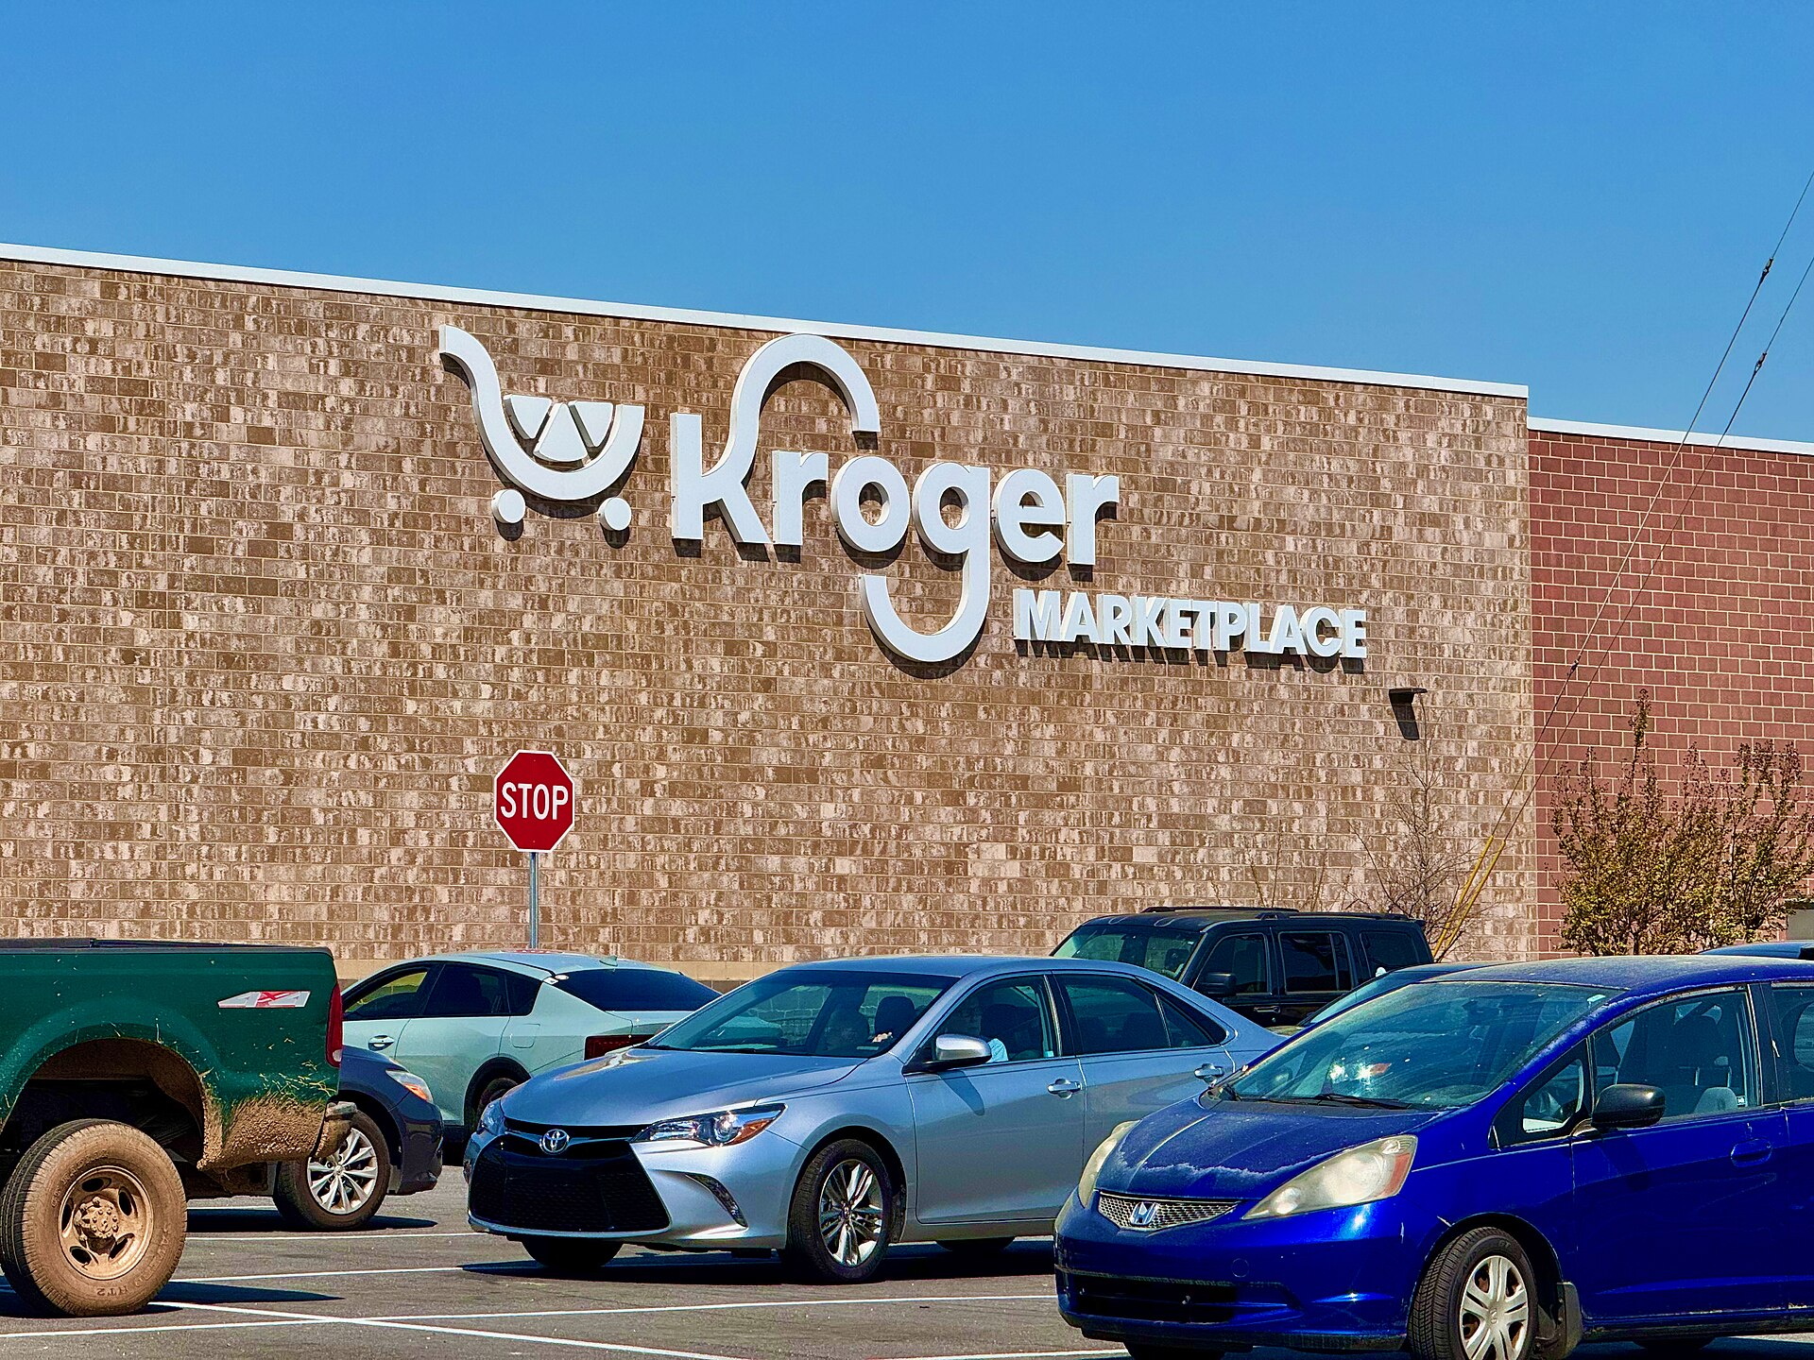
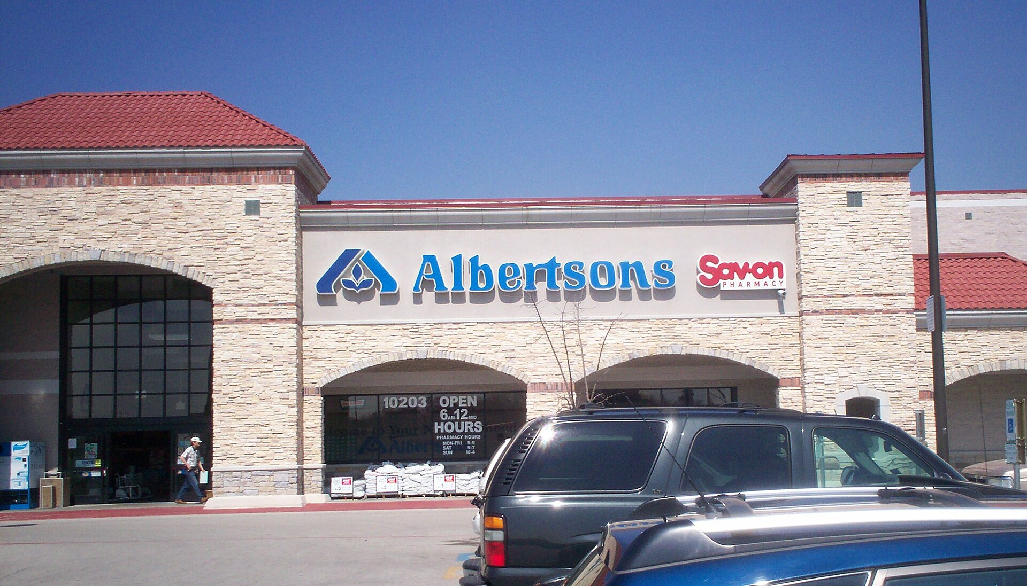
Module 1 · Candidates · Market Definition
Market Definition Mini-Case: Kroger–Albertsons
Oct 2022: Kroger agrees to buy Albertsons for $24.6B — the largest US supermarket merger ever proposed
Once again, everything would hinge on how you define the market:
The firms: we are small next to Walmart, Amazon, Costco
FTC: the market is “supermarkets” — assessed city by city, where #1 was buying #2
Photos: Wikimedia Commons
Management 405 · Module 1 · Example Candidates (for review)
4
Notes:
Expanded from the candidate list (verified 2026-08-20). Judge Adrienne Nelson (D. Or.) granted the FTC's preliminary injunction 10 Dec 2024 after a three-week hearing; a Washington state court blocked the deal under state law the same day. The proposed divestiture of 579 stores to C&S Wholesale was rejected as inadequate. Aftermath: Albertsons sued Kroger for the $600M termination fee (ongoing 2026). Teaching beat (chronological): this slide sets up the case and ends on 'market definition would turn out to be crucial'; the next slide resolves it.
Photos: Wikimedia Commons (Kroger Marketplace, Athens GA; Albertsons, Dallas).

Slide 5
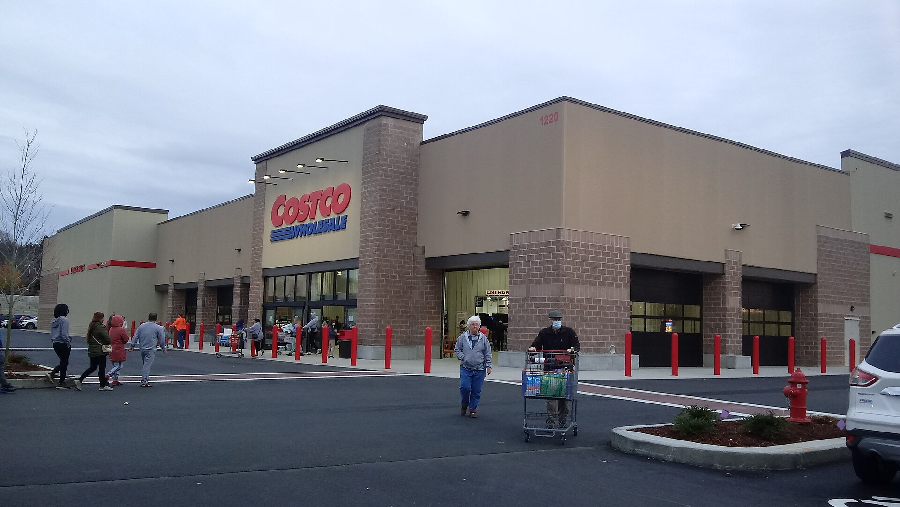
Module 1 · Candidates · Market Definition
Is a “Costco Run” a Substitute for Everyday Shopping?
THE MARKET: “supermarkets” — Kroger · Albertsons · Safeway …
Outside the market:
Club stores — Costco, Sam's Club
Limited assortment — Aldi, Trader Joe's
Dollar & convenience stores
Online-only sellers
Photo: Wikimedia Commons
“A monthly trip to Costco to stock up … does not make a ‘Costco run’ a reasonable substitute for a weekly one-stop visit to a supermarket.”
— Judge Adrienne Nelson, D. Or. (Dec 2024)
Dec 2024: federal and state courts block the deal — some substitution is not enough substitution
Management 405 · Module 1 · Example Candidates (for review)
5
Notes:
The court also recognized a broader 'large-format store' market that DOES include club stores — the narrow supermarkets market is where the presumption of illegality arose. Open point: whether Walmart supercenters sat inside the narrow market is not pinned down — keep supercenters off the slide. Teaching beat (chronological): market diagram, then the Nelson quote, then the Dec 2024 gold decision bar as the final click. On-slide source line dropped for space — cite: D. Or. preliminary injunction (Dec 10, 2024); SMU post-mortem; Grocery Dive.

Slide 6
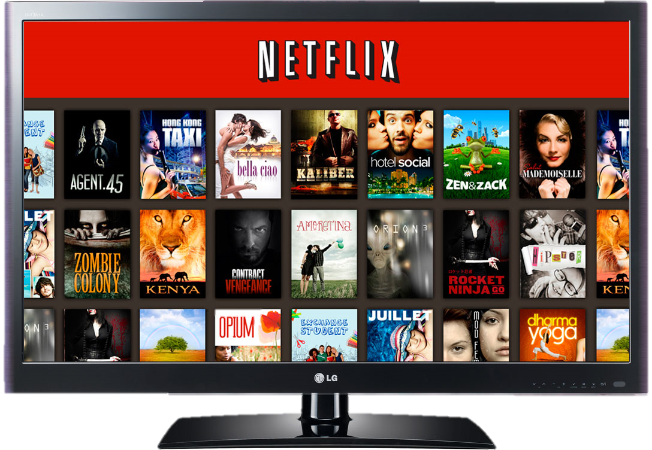
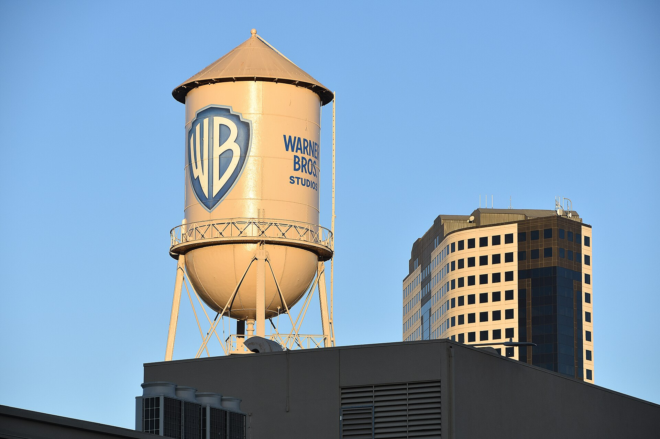
Module 1 · Candidates · Market Definition
Mini-Case: Netflix Bids for Warner Bros (2025–26)
Every side defined the market to fit its answer — Netflix, the DOJ, and 12 state AGs
Photo: Wikimedia Commons
Dec 2025
Feb 2026
Feb 26, 2026
Jul 2026
Netflix agrees to buy WB studios + HBO Max (~$83B reported)
DOJ opens an antitrust probe
Paramount outbids (~$110.9B); Netflix withdraws
12 state AGs sue Paramount–WBD — over theatrical film + cable markets
Management 405 · Module 1 · Example Candidates (for review)
6
Notes:
Timeline verified 2026-08-20: WBD–Netflix merger agreement 4 Dec 2025; DOJ civil investigative demands Feb 2026 ('may substantially lessen competition'); WBD board declared Paramount Skydance's ~$110.9B offer superior 26 Feb 2026 and Netflix withdrew; 12 state AGs (led by CA's Bonta) sued 13 Jul 2026 in N.D. Cal. — alleging harm in wide-release theatrical distribution (~27% combined), top-grossing theatrical (>30%), and basic-cable licensing (~27%), not in streaming.
Photo: Warner Bros. Studios water tower, Wikimedia Commons.

Slide 7
Module 1 · Candidates · Market Definition
9% of TV Time — or 33% of Streaming? Pick Your Market
12.9
Netflix's market: all TV time
Netflix + HBO Max = 9.2% — “#3 behind YouTube and Disney”
11.4
8.6
8.4
8.2
8.0
5.6
Narrow SVOD market: ~33% combined — presumptively illegal concentration
YouTube
Disney
NBCU
Fox
Paramount
Netflix
WBD
(HBO Max: 1.2)
Share of US TV time, Oct 2025 (Nielsen, via Netflix's investor deck)
Both numbers are correct arithmetic — the market definition does all the work
Management 405 · Module 1 · Example Candidates (for review)
7
Notes:
On-slide source line dropped for space — cite: Netflix investor deck (Dec 2025, Nielsen Oct 2025); ProMarket / Wolfram (Feb 2026). Bars: Nielsen 'Share of US TV Time by Distributor', Oct 2025, as published in Netflix's own investor deck (Dec 2025): YouTube 12.9, Disney 11.4, NBCU 8.6, Fox 8.4, Paramount 8.2, Netflix 8.0, WBD 5.6 (of which HBO/HBO Max 1.2) — Netflix + HBO Max = 9.2%. SVOD framing: Wolfram/ProMarket (5 Feb 2026): combined ~33% of SVOD, HHI 2,055, delta 829 — over the structural presumption. Build: bars first, Netflix framing box, then the red SVOD box as the punchline.

Slide 8
Module 1 · Candidates · Supply and Demand
Eggs 2024–2026: A Supply Shock in Fast-Forward
Avian flu culled the laying flock: supply shifts left, demand unchanged
Retail eggs: $2.52/dozen (Jan 2024) → $6.23 (Mar 2025) → $2.19 (Jul 2026) — BLS data
Inelastic demand: a supply loss well under 15% produced a 147% price spike
Rationing without prices: Trader Joe's 1-dozen limits; Waffle House's transparent 50¢-per-egg surcharge (Feb–Jul 2025)
Teaching angle: The cleanest fully-verified S/D episode available — and hens regrow in months, so the whole cycle reversed inside two years. Slots naturally after the tea and avocado mini-cases.
Proposed visual: Native line chart of the BLS retail egg-price series 2024–26 (data already pulled)
Discussion: Supply fell under 15%, price rose 147% — what does that ratio say about the demand curve, and would you pass the cost through?
Sources: BLS series APU0000708111 (retrieved 2026-08-20); USDA (2025); GMA (purchase limits); CNN / Fortune (Waffle House)
Management 405 · Module 1 · Example Candidates (for review)
8
Notes:
Price series pulled directly from the BLS public API on 2026-08-20 (series APU0000708111, Grade A large, US city average) — fully verified. Secondary flavor: >150M birds culled by early Feb 2025; purchase limits at Trader Joe's (1 dozen), Sprouts (4), Costco (5 online); Waffle House surcharge Feb 4 – early Jul 2025. Optional dark twist for class: DOJ + 17 states' Jun 2026 civil settlement with Cal-Maine et al. over Urner Barry benchmark manipulation ($3.3M + 53M donated eggs, no admission) — separates scarcity pricing from manipulation.
Sources:
https://api.bls.gov/publicAPI/v1/timeseries/data/APU0000708111
https://www.usda.gov/about-usda/news/press-releases/2025/03/20/usda-update-progress-five-pronged-strategy-combat-avian-flu-and-lower-egg-prices
https://www.goodmorningamerica.com/food/story/trader-joes-costco-sprouts-limit-purchases-fresh-eggs-118654037
https://www.cnn.com/2025/02/04/food/waffle-house-egg-surcharge/index.html

Slide 9

Module 1 · Candidates · Supply and Demand
Mini-Case: AI Eats the Memory Supply (2025–26)
2025: the AI datacenter buildout explodes demand for high-bandwidth memory (HBM)
New chip fabs take years — industry capacity is essentially fixed for 2–3 years
Oct 2025: SK Hynix — DRAM, NAND and HBM capacity “essentially sold out” for 2026
The same wafers can become AI memory or ordinary laptop memory — that allocation would drive the story
Photo: Wikimedia Commons
Management 405 · Module 1 · Example Candidates (for review)
9
Notes:
Setup slide (chronology-first): builds the situation and ends on the wafer-allocation flag; the S/D analysis and the price outcome follow on the next two slides. Confirmed: SK Hynix's 'essentially sold out' statement is from its Oct 2025 earnings call, corroborated across independent outlets.
Sources:
https://www.networkworld.com/article/4113772/samsung-warns-of-memory-shortages-driving-industry-wide-price-surge-in-2026.html
https://www.trendforce.com/presscenter/news/20260105-12860.html

Slide 10
Module 1 · Candidates · Supply and Demand
Two Linked Markets, One Pool of Wafers
HBM — AI memory
Consumer DRAM (DDR5)
Price ($)
Price ($)
S
S’
S
P1
P1
wafers reallocated to the higher-margin use
D’
P0
P0
D
D
Quantity
Q1
Q0
Quantity
Nothing physically broke — the marginal wafer flowed to its best-paying use: opportunity cost as a supply-side force.
Management 405 · Module 1 · Example Candidates (for review)
10
Notes:
Two-panel S/D schematic (values illustrative). Left: AI demand shifts right hard against a steep, near-fixed short-run supply — price does almost all the adjusting. Right: the SAME wafer capacity is reallocated toward high-margin HBM, so the consumer-DRAM supply curve shifts LEFT with demand unchanged — price up, quantity down. A demand shock in one market becomes a supply shock in the linked one. Teaching beat: left panel first (D→D'), then the gold reallocation arrow, then the right panel (S→S'), takeaway box last.

Slide 11

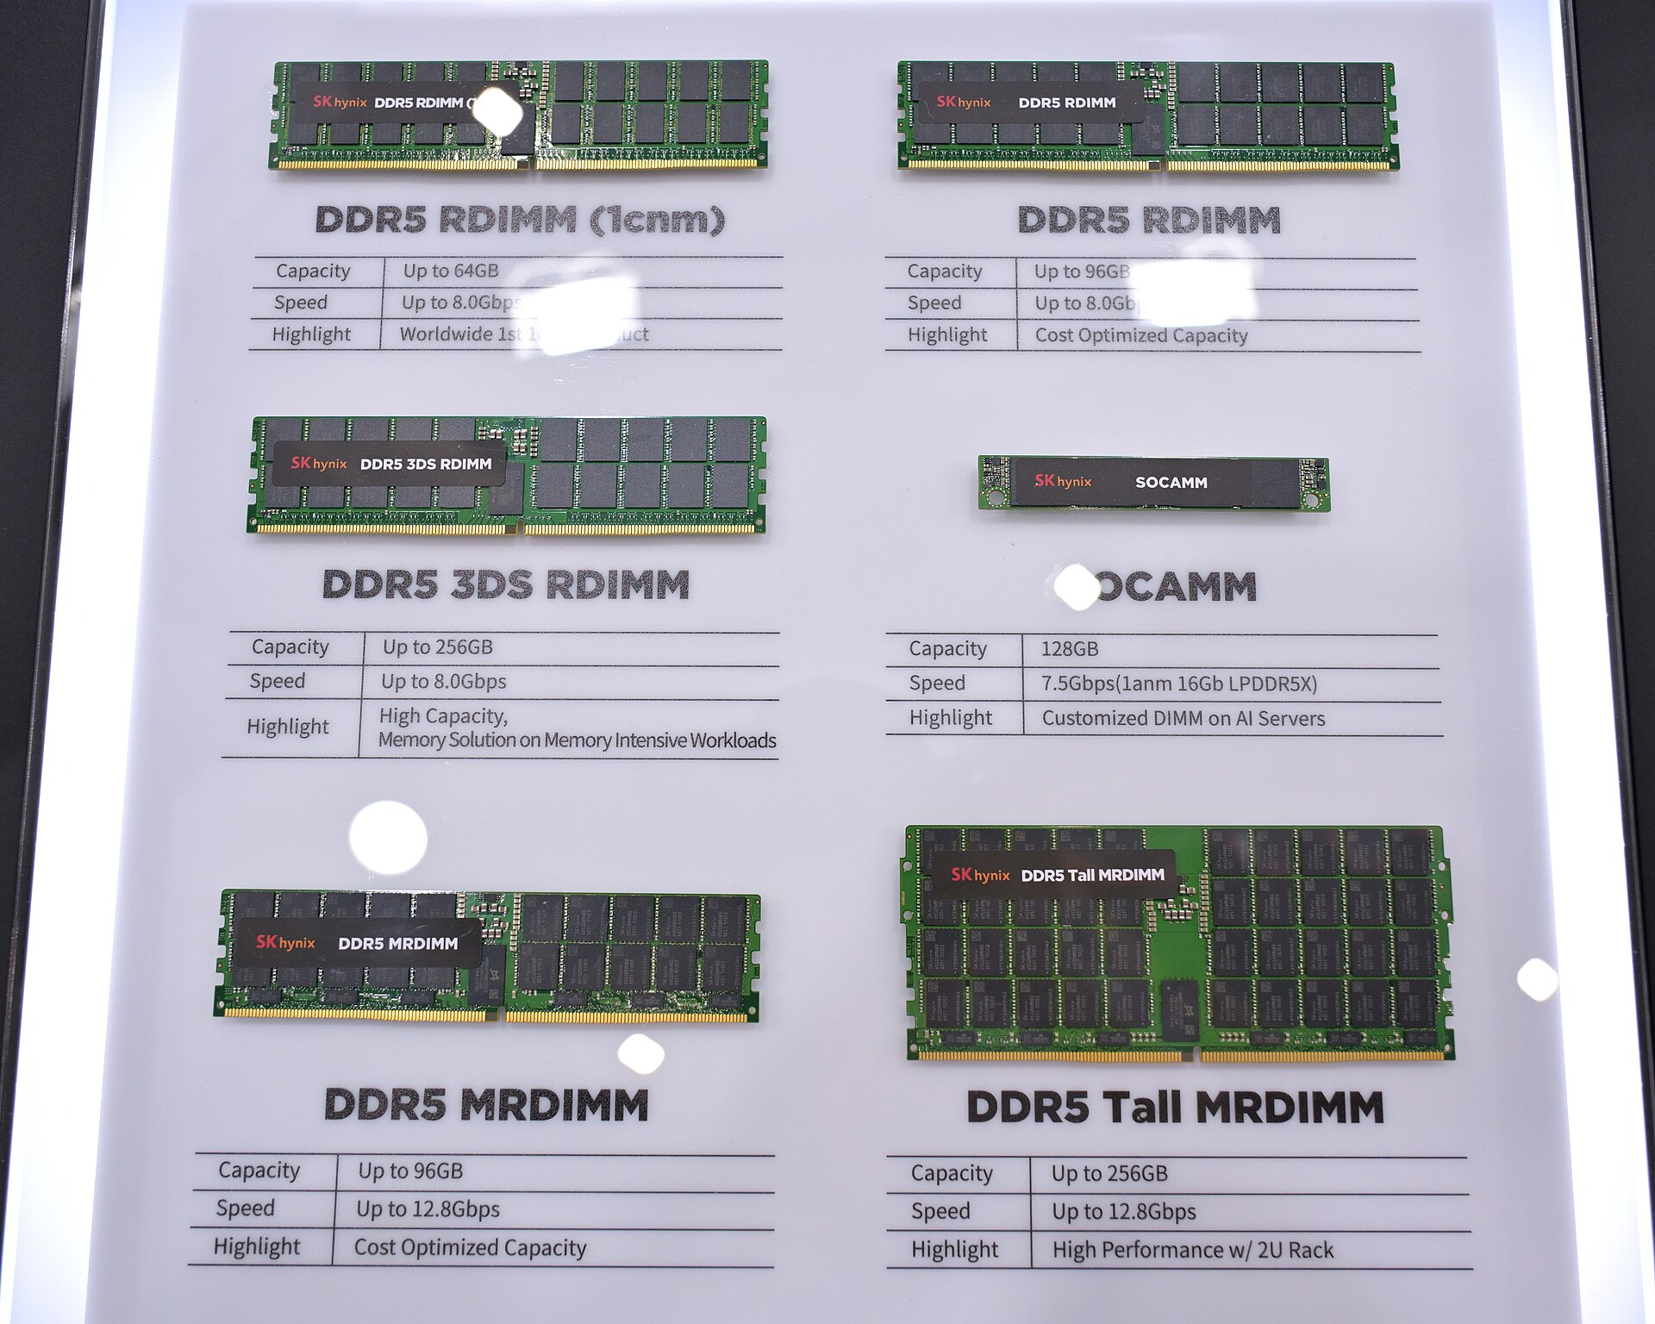
Module 1 · Candidates · Supply and Demand
Resolution: Prices Double — High Prices Can't Fix This Quickly
Q1 2026: conventional DRAM contract prices roughly double in a single quarter (TrendForce, reported)
Samsung reportedly reprices a 32GB DDR5 module $149 → $239 in one step (+60%)
HBM's share of DRAM wafer output: ~19% → ~23% (2026, reported); makers signal tightness into 2028
New fabs take 2–3 years — quantity can't respond, so price does all the work
Discussion: No factory burned down, yet laptop-memory supply contracted. What contract terms protect you when your input has a better-paying alternative use?
Sources: TrendForce press center (2026, reported); Network World; SK Hynix earnings call (Oct 2025)
Photos: Wikimedia Commons
Management 405 · Module 1 · Example Candidates (for review)
11
Notes:
Resolution slide (final beat when animated). VERIFICATION: the direction and mechanism are corroborated across independent outlets, but the MAGNITUDES (the ~93–98% QoQ Q1-2026 contract-price move, the $149→$239 Samsung repricing, the 19%→23% HBM wafer share) are press-reported TrendForce figures surfaced via search, not primary-fetched — re-verify the TrendForce releases before this graduates into the main deck.
Photos: NVIDIA H100 accelerators (where the wafers went) and SK Hynix DDR5 modules — Wikimedia Commons.
Sources:
https://www.trendforce.com/presscenter/news/20260601-13070.html
https://www.trendforce.com/presscenter/news/20260105-12860.html
https://www.networkworld.com/article/4113772/samsung-warns-of-memory-shortages-driving-industry-wide-price-surge-in-2026.html

Slide 12
Module 1 · Candidates · Opportunity Costs
The $100M Question: What It Costs to Stay
Altman (Jun 2025): Meta offered OpenAI staff “$100 million signing bonuses” — confirmed quote
Meta's CTO: multi-year stock packages, not sign-on bonuses — “the market's hot. It's not that hot.”
NYT-reported: one 24-year-old researcher's Meta package ~$250M over 4 years (reported, not confirmed)
A researcher who declines $100M pays $100M — in implicit cost — to stay
Teaching angle: Retention is a purchase at the market price: the outside offer is the implicit cost of staying, whether or not payroll ever records it. Companion to the full-economic-cost-of-an-MBA discussion.
Proposed visual: Explicit-vs-implicit cost ledger + Meta / OpenAI logos
Discussion: Your star engineer declines an offer at 3× the current package. Has your cost of employing her/him changed — and what if the accountants say no?
Sources: Bloomberg / CNBC (Jun 2025); TechCrunch (Jun 2025); NYT (Aug 2025, reported)
Management 405 · Module 1 · Example Candidates (for review)
12
Notes:
Confirmed: Altman's Uncapped-podcast statement (17 Jun 2025) and Bosworth's all-hands pushback (via The Verge/TechCrunch); researcher Lucas Beyer publicly denied receiving $100M sign-on. Reported only: the ~$250M/4-year package (~$100M year one) for Matt Deitke, NYT-attributed via relays; Meta total outlay >$1B on ~50 hires. Do not put the $250M on a main-deck slide without reading the NYT piece.
Sources:
https://www.bloomberg.com/news/articles/2025-06-17/altman-says-meta-offered-openai-staffers-100-million-bonuses
https://www.cnbc.com/2025/06/18/sam-altman-says-meta-tried-to-poach-openai-staff-with-100-million-bonuses-mark-zuckerberg.html
https://techcrunch.com/2025/06/27/meta-is-offering-multimillion-dollar-pay-for-ai-researchers-but-not-100m-signing-bonuses/

Slide 13
Module 1 · Candidates · Opportunity Costs
Return-to-Office: A Pay Cut That Never Hits Payroll
Working from home saves 72 minutes per day on average, across 27 countries (AEA P&P 2023)
Workers put ~40% of the saved time back into the job
Amazon: five days in office from January 2, 2025 (company announcement)
S&P 500 firms: ~14% higher turnover after RTO mandates, concentrated among senior staff (working paper)
Teaching angle: Commuting time is compensation priced at zero on the books: a mandate raises the true cost of the job without touching payroll, and the market clears it through quits and wage demands. Core numbers are peer-reviewed (Aksoy, Barrero, Bloom et al.).
Proposed visual: 72-minute clock split (job / caregiving / leisure) + commute schematic
Discussion: If 5 days in office means ~6 unpaid commuting hours a week, what raise leaves your staff indifferent — and is the in-person gain bigger than that?
Sources: Aksoy et al. (AEA P&P 2023); Barrero, Bloom & Davis (JEP 2023); aboutamazon.com (Sep 2024); SSRN 5031481
Management 405 · Module 1 · Example Candidates (for review)
13
Notes:
Peer-reviewed anchors: Aksoy, Barrero, Bloom, Davis, Dolls & Zarate, AEA Papers & Proceedings 113 (2023): WFH saves 72 min/day, ~40% reinvested in work, ~11% caregiving. Barrero-Bloom-Davis JEP 2023: full WFH days = 28% of paid US workdays mid-2023. The 14%-turnover result (Ding et al., SSRN 5031481) is an unpublished working paper — present as suggestive. Avoid vendor-survey dollar figures ('$8,158 invisible pay cut').
Sources:
https://www.aeaweb.org/articles?id=10.1257/pandp.20231013
https://www.aeaweb.org/articles?id=10.1257/jep.37.4.23
https://www.aboutamazon.com/news/company-news/ceo-andy-jassy-latest-update-on-amazon-return-to-office-manager-team-ratio
https://papers.ssrn.com/sol3/papers.cfm?abstract_id=5031481

Slide 14
Module 1 · Candidates · Sunk Costs
Walking Away from $10 Billion: Apple Car and GM Cruise
Apple (Feb 2024): killed Project Titan after ~10 years, ~2,000 staff, reported >$10B — zero cars shipped
GM (Dec 2024): stopped funding Cruise robotaxis after reported $10B+ since 2016
GM's forward math (SEC-filed): pay a $0.5B exit charge to stop a $1.7B-per-year outflow
In both decisions, the $10B already spent appears nowhere
Teaching angle: The modern Concordes, decided correctly: forward margins and forward costs drove both exits. GM's numbers are filing-confirmed — a rare fully quantified exit calculation.
Proposed visual: Cruise robotaxi photo + a two-column sunk-vs-forward ledger for the GM decision
Discussion: GM paid $522M to quit. Under what conditions is paying half a billion dollars to stop the value-maximizing move?
Sources: GM Q4-2024 8-K (SEC); CNBC (Dec 2024 / Feb 2025); NYT & Bloomberg (Feb 2024; Apple $10B reported, not disclosed)
Management 405 · Module 1 · Example Candidates (for review)
14
Notes:
Confirmed from GM's Q4 2024 8-K: $0.5B Q4 charges (Cruise net $522M incl. $173M non-cash), $1.7B spent on Cruise in 2024, ~$1B expected annual run-rate savings. Reported (not filed): the cumulative $10B+ figures for both Apple and GM; Apple has never disclosed Project Titan spend — say 'reported at more than $10 billion'. Apple staff largely redirected to the generative-AI organization; ~1,000 Cruise layoffs Feb 2025, tech folded into Super Cruise. Honest complication: the Oct 2023 Cruise pedestrian incident changed the FORWARD probability of scaling — new information, not sunk cost, moved GM.
Sources:
https://www.sec.gov/Archives/edgar/data/1467858/000146785825000030/gmq42024pressreleaseandfin.htm
https://www.cnbc.com/2024/12/10/gm-halts-funding-of-robotaxi-development-by-cruise.html
https://www.macrumors.com/2024/02/28/apple-car-10-billion-spent/

Slide 15
Module 1 · Candidates · Sunk Costs
Meta's Metaverse: $80B of Losses — Patience or Escalation?
Reality Labs operating losses: roughly $80–84B cumulative 2020–2025 (FY2025: $19.2B loss on $2.2B revenue — filings)
Losses rose EVERY year for six years; revenue stuck near $2B
2026 pivot: ~1,500 Reality Labs layoffs; Horizon Worlds moved to mobile; budget shifted to AI glasses
Meta's defense was forward-looking: option value on the next computing platform
Teaching angle: The contested case: an escalation-of-commitment pattern versus genuine platform option value. When Meta finally cut, its stated reasons were about future returns — not recovering the $80B. Ideal debate slide after Concorde.
Proposed visual: Native bar chart: Reality Labs annual operating losses 2020–2025
Discussion: What evidence, visible in 2023 rather than in hindsight, would distinguish patient platform investment from escalating commitment?
Sources: Meta Q4-2025 results (SEC Ex. 99.1); CNBC (Jan 2026); TechCrunch (Feb 2026)
Management 405 · Module 1 · Example Candidates (for review)
15
Notes:
Confirmed from filings/tier-1: FY2025 loss $19.19B on $2.21B revenue; FY2024 $17.73B; Q4-2025 $6.02B. Cumulative 2020–25 sums to ~$83.6B from disclosed segment losses (2020 $6.62B, 2021 $10.19B, 2022 $13.71B, 2023 $16.12B) — say 'roughly $80–84B'. Reported: ~1,500 layoffs (~10%) Jan 2026; Horizon Worlds to mobile 20 Feb 2026; 'up to 30%' metaverse budget cut is press-reported only.
Sources:
https://www.sec.gov/Archives/edgar/data/1326801/000162828026003832/meta-12312025xexhibit991.htm
https://www.cnbc.com/2026/01/28/metas-reality-labs-posts-6point02-billion-loss-in-fourth-quarter.html
https://techcrunch.com/2026/02/20/meta-metaverse-leaves-vr-horizon-worlds-mobile/

Slide 16

Module 1 · Candidates · Cost-Benefit and Marginal Analysis
Mini-Case: Airlines and the 2026 Fuel Shock
Mar 2026: jet fuel “more than doubled in the last three weeks” (Kirby memo)
United cuts ~5% of planned capacity:
~3pp off-peak, midweek and red-eye flying
~1pp Chicago O'Hare; ~1pp Tel Aviv / Dubai
Delta follows: off-peak and red-eyes are “15% to 20% less valuable on a net revenue basis” (CCO Esposito)
Aircraft orders and 2027 capacity: unchanged
Photo: Wikimedia Commons
“There's no point in burning cash in the near term on flying that just can't absorb these fuel costs. … Nothing changes about our longer-term plans.”
— Scott Kirby, United CEO (staff memo, Mar 2026)
Sources: Kirby memo via Fox Business / CNBC (Mar 2026); Travel Market Report (Apr 2026)
Management 405 · Module 1 · Example Candidates (for review)
16
Notes:
Verified 2026-08-20 from coverage of the 20 Mar 2026 memo: ~5% capacity cut; United modeling oil to $175/bbl and >$100 through 2027 (≈$11B added annual fuel cost — 'more than twice the profit it earned in its best year ever'). Delta (Apr 2026, EVP Joe Esposito) targeted off-peak/edge-of-day/red-eyes. Short run vs. long run stated by the CEO himself.
Photo: United 787-8, Wikimedia Commons.

Slide 17
Module 1 · Candidates · Cost-Benefit and Marginal Analysis
When MC Jumps, Cut the Marginal Flight — Not the Fleet
$ per flight
MR of flights (ranked)
MC — fuel ×2
MC — normal fuel
the ~5% cut: off-peak and red-eyes first
Q1*
Q0*
Flights
Shed exactly the flights between the old and new MB = MC crossing — short run only; the fleet (long run) stays.
Management 405 · Module 1 · Example Candidates (for review)
17
Notes:
Schematic (values illustrative): flights ranked by marginal revenue give a downward MR line; fuel is the textbook marginal cost, so a fuel-price doubling shifts MC up and the crossing left. The flights between Q0* and Q1* — the red-eyes and off-peak departures 15–20% below average revenue — are exactly the ones cancelled. Lands right after the exercise-hours and continuous MB=MC slides (57–59).

Slide 18
Module 1 · Candidates · Market Mechanism and Fairness
After the LA Fires: A 10% Rent Cap Meets a Housing Shortage
Jan 7, 2025 emergency: CA Penal Code §396 capped rent increases at 10% — with criminal penalties
Illegal to ACCEPT more — even if the tenant volunteers it (AG Bonta)
750+ warning letters by Jun 2025; realtors criminally charged (one listing >50% above pre-fire rent)
Scraped Zillow data (advocacy group, reported): ~15% of updated listings above the cap; 2-bedrooms up ~80%
Teaching angle: The “shortages when disasters loom” discussion (slide 29) with a case from the students' own zip codes: a binding cap converts a price rise into non-price rationing — queues, networks, non-compliance — and writes the fairness intuition into criminal law.
Proposed visual: LA-fires photo + native S/D chart with a price ceiling below the market-clearing rent
Discussion: If the cap had been lifted on Jan 8 and rents had doubled — who gets the housing, and is that allocation better or worse?
Sources: CA AG press releases (Jan–Jun 2025); Gov. Newsom EOs (Mar 2025, Jan 2026); NLIHC / Rent Brigade (reported)
Management 405 · Module 1 · Example Candidates (for review)
18
Notes:
Confirmed from CA AG / Governor's office: §396 activated 7 Jan 2025; 10% cap; penalties up to 1 year jail / $10,000 + $2,500 civil per violation; 200+ warning letters by 18 Jan, 650+ by 28 Jan (second realtor charged, Glendale listing >50% above list), 750+ by Jun 2025; protections extended to 1 Jul 2025. Reported (advocacy scrape, not official): Rent Brigade Zillow analysis — 15% of updated listings (1,343) above cap, studios +57%, 2BRs +80%, only 9% corrected. OPEN: whether a housing-specific cap is still active in LA County as of Aug 2026 (the Jan 2026 EO covers building materials/reconstruction).
Sources:
https://www.oag.ca.gov/news/press-releases/attorney-general-bonta-rental-bidding-wars-during-la-wildfires-prohibited-under
https://www.oag.ca.gov/news/press-releases/attorney-general-bonta-charges-second-los-angeles-realtor-price-gouging-victims
https://nlihc.org/resource/report-finds-emergency-declaration-los-angeles-wildfires-was-followed-rent-gouging

Slide 19
Module 1 · Candidates · Bench
Bench: More Candidates I — Markets, Supply and Demand
Market definition
FTC v. Meta (Nov 2025): narrow market REJECTED — TikTok/YouTube converged; the counterexample to Tapestry/Kroger
Google search remedies (Sep 2025): are AI chatbots in the market? Outside for liability, inside for the remedy
FTC v. Amazon “online superstore”: two adjectives do all the work; trial Mar 2027 — prompt, not case
Supply and demand
US beef 2024–26: +37% (BLS), smallest herd since 1951 — slow biological supply response vs. eggs' fast one
Coffee: retail +52% (BLS-verified) while futures retreated — the pass-through lag executives misread
Cocoa: price fell ~70% while consumption ALSO fell — you need quantity, not just price, to identify the shift
GLP-1 drugs: administered prices → queues, waitlists, and a compounding gray market instead of price increases
Management 405 · Module 1 · Example Candidates (for review)
19

Slide 20
Module 1 · Candidates · Bench
Bench: More Candidates II — Opportunity and Sunk Costs
Opportunity costs
Berkshire's record ~$397B cash (Q1 2026, reported) and Abel's deployments: OxyChem $9.5B, Taylor Morrison, buybacks
Hyperscaler AI capex ~$700B (2026, big four): the required return that never appears on the income statement
NIL-era draft decisions: staying in college now has a price tag ($6.5M reported NIL offer vs. NFL rookie deal)
Sunk costs
California high-speed rail: approved 2008 at $9B, Phase I now $126B (LAO) — the fallacy in its political habitat
Ørsted's Hornsea 4 (May 2025): paid up to ~DKK 5B to quit despite a locked-in price — quitting has a price tag
Sony's Concord (2024): finished game taken offline in 14 days with full refunds — “it's finished” is not a reason
Management 405 · Module 1 · Example Candidates (for review)
20

Slide 21
Module 1 · Candidates · Bench
Bench: More Candidates III — Marginal Analysis and Fairness
Marginal analysis and fairness
Google datacenter demand response (1 GW by 2026): sell the megawatt, not the compute — the marginal-value comparison
Wendy's “surge pricing” (2024): identical mechanism, opposite reception as discount vs. surcharge — the framing lesson
Egg rationing 2025: Trader Joe's quantity limits vs. Waffle House's surcharge; DOJ 2026 benchmark-manipulation settlement
Management 405 · Module 1 · Example Candidates (for review)
21

